Slide 1
Senior Design 2- Design of a Plant Health prediction application
Progress report
Timothy Riley

Slide 2
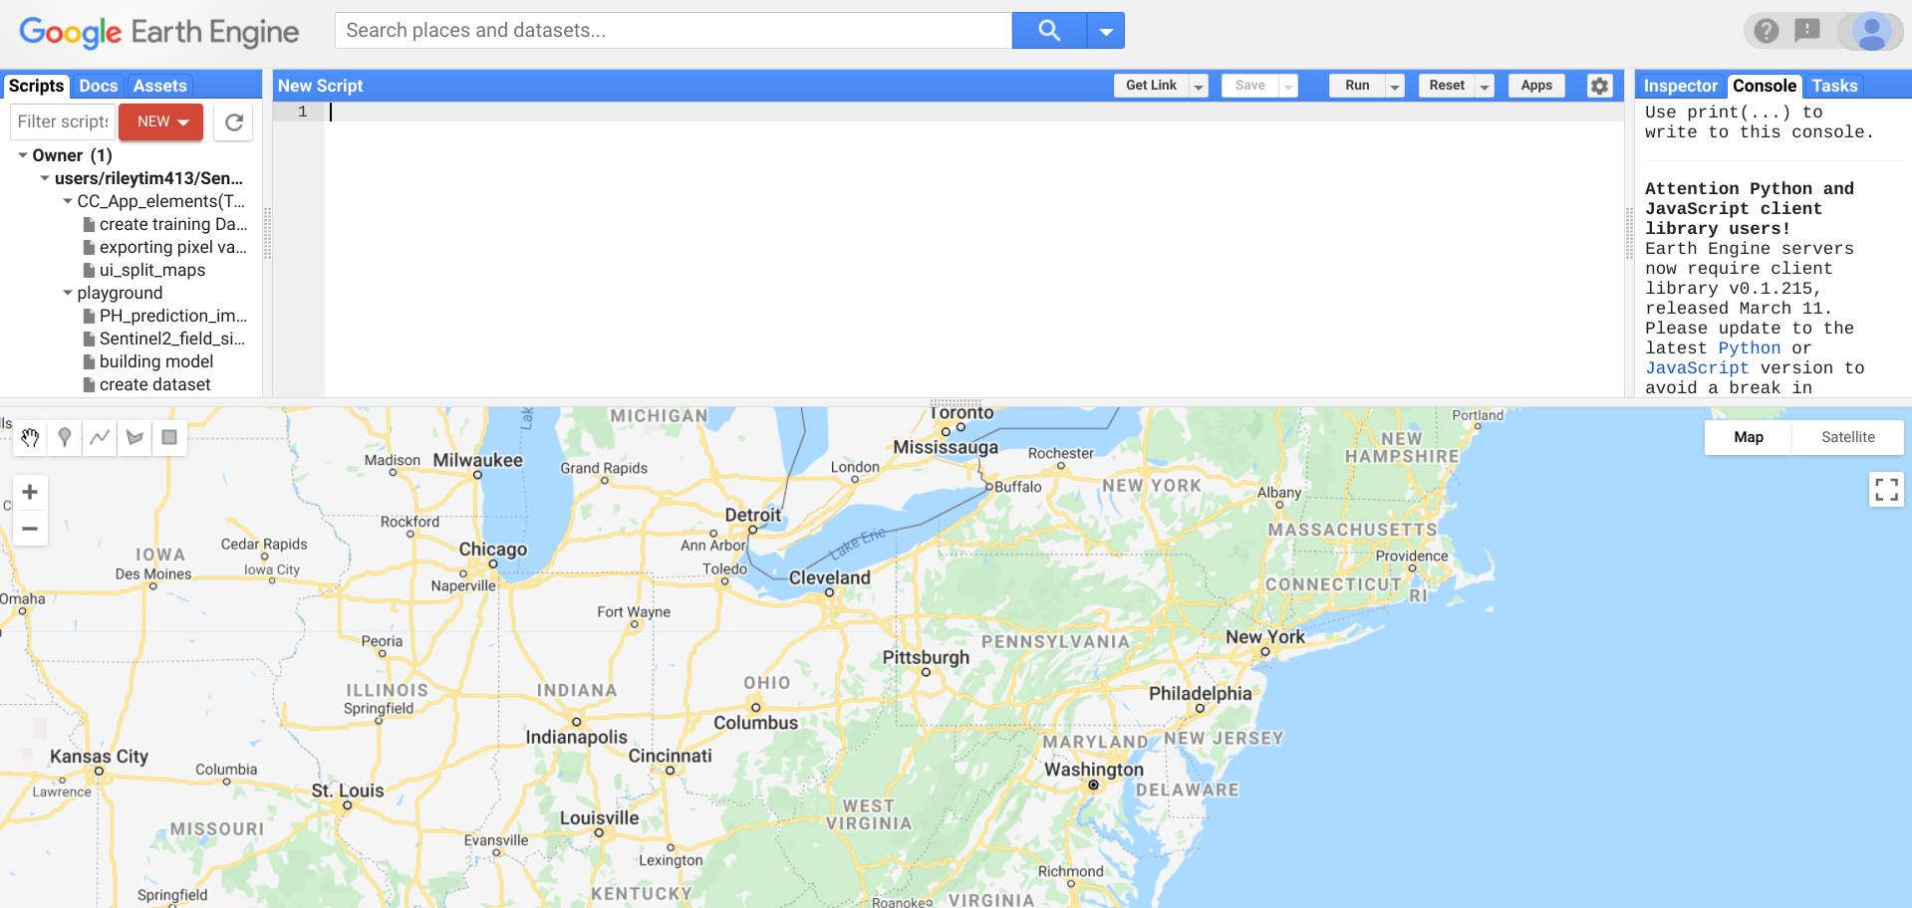
Re-cap
Objective :
This project will be the development of a web application in Google Earth Engine that performs plant health predictions on satellite images with implementation of a machine learning algorithm. Displaying concentrations of Biomass and % nitrogen from satellite imaging

Slide 3
Tasks
Task 1. Preprocessing the Dataset
Subtask 1. isolate necessary information from satellite
Subtask 2. isolate vital information from field site data
Subtask 3. Correlate quadrat data to pixel location in satellite images
Subtask 4. Build Dataset input pipeline
Task 2. Produce Machine learning Model
Subtask 1. Build Model structure & begin initial training.
Subtask 2. Collect results, revise and retrain the network.
Task 3. Develop Alpha-Application in GEE
Subtask 1. Build UI that accesses Sentinel - II satellite images
Subtask 2. Add coordinate location functionality
Subtask 3. Add image capture functionality

Slide 4
Tasks con.
Task 4. Backend Development
Subtask 1. Preprocess the captured image for compatibility to model nput
Subtask 2. Integrate the trained neural net model into the GEE API
Subtask 3. Write code to associate prediction output values with satellite image pixel locations
Task 5. Frontend
Subtask 1. Convert Biomass and Nitrogen % predictions to Raster Map data values
Subtask 2. Write code to Draw Raster map over satellite image
Subtask 3. Build User Interface for interaction with the Raster map
Task 6. Testing and Refinement
Subtask 1. Test the operability of the application and its ease of use
Subtask 2. Refine the Apps use and workflow

Slide 5
Current status
Produced code to Extract band values from the pixels of satellite images
Tested some User Interface capability of the code
Have an idea for the initial structure of the Machine Learning model
First model will be built in the GEE API but may transfer to Tensorflow based on progress/results
Awaiting the full dataset of training features [biomass, nitrogen, coordinates]
Have received a synthetic dataset to work on the workflow for the model training

Slide 6
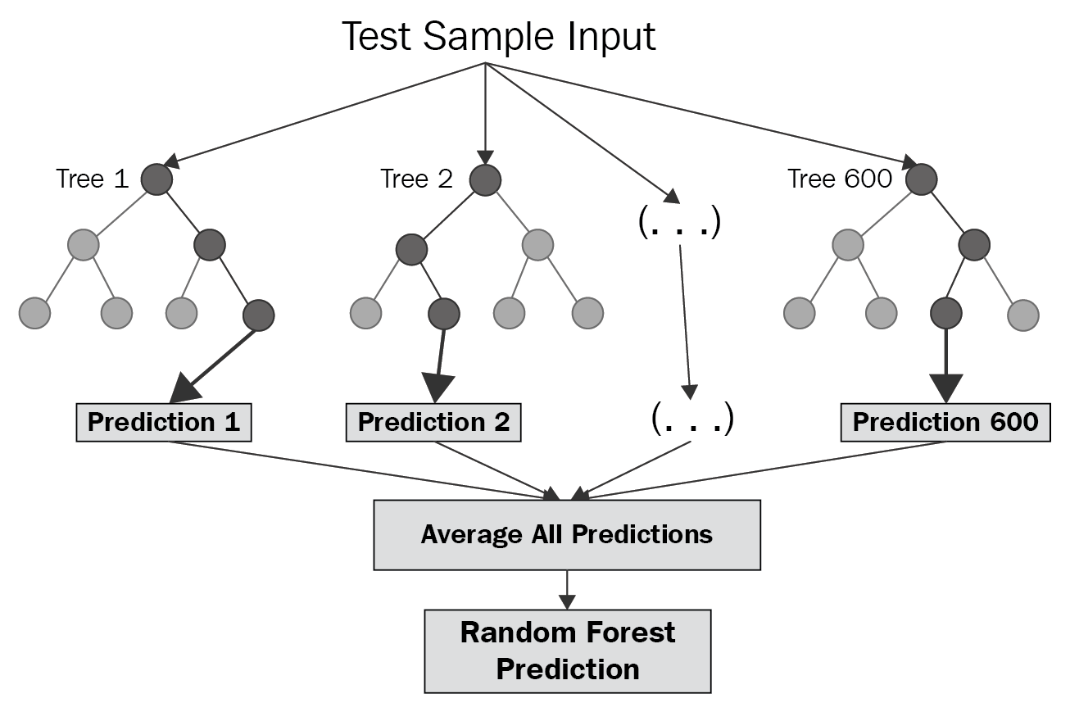
Next step
Build the Machine learning model and use the synthetic dataset to produce a preprocessing script that can be used to convert feature collections to a trainable dataset for the ML model.

Slide 7
Build Dataset Input Pipeline
Wrote Dataset preprocessing script using the synthetic dataset.
Takes feature collection with field level data and imports as a table
Reads/extracts the coordinates for each feature in the collection
Associates the Sentinel 2 image pixel with the proper feature based on coordinates
Extracts the band values from the selected pixels
Combines the band values with the field level data for each feature and saves as a new feature collection
Splits the full dataset so 80% is for training and 20% is for validation

Slide 8
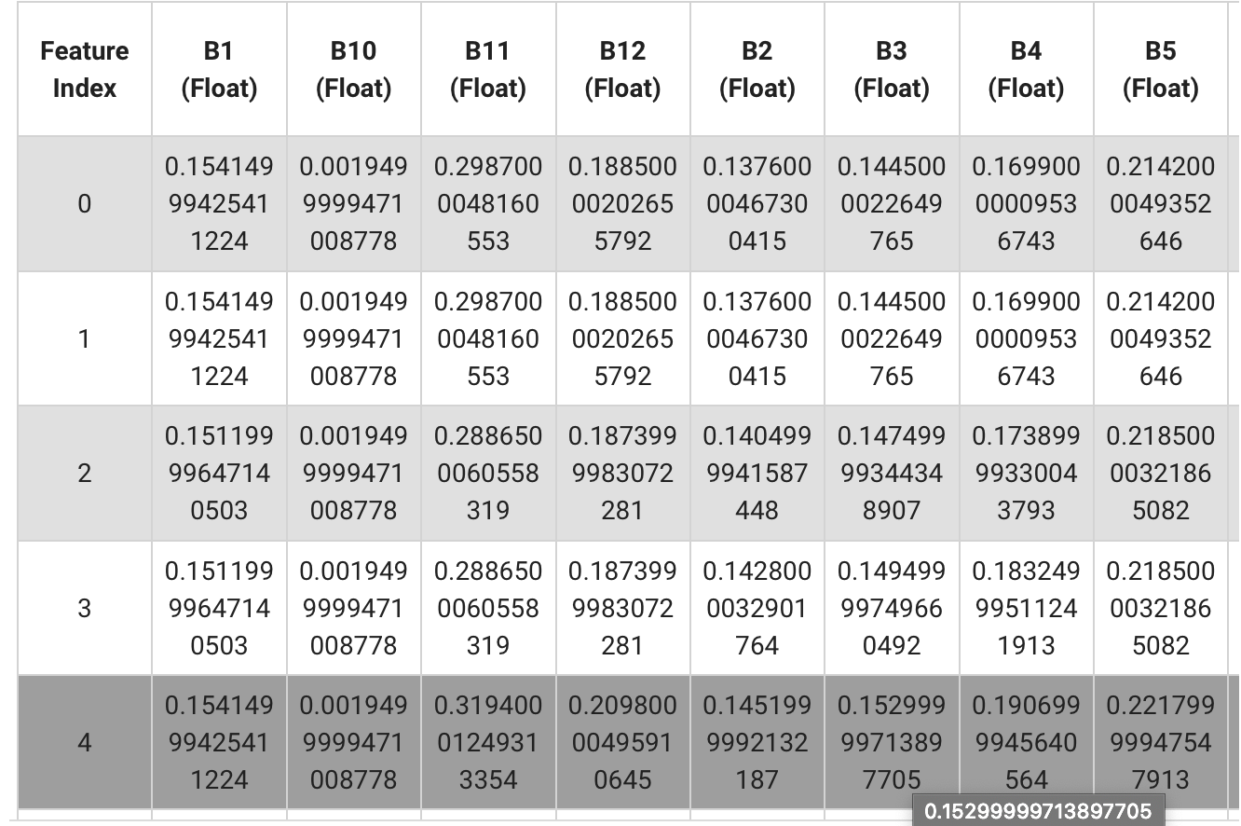
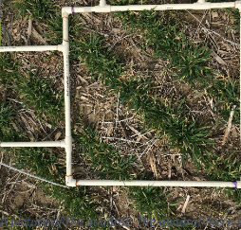
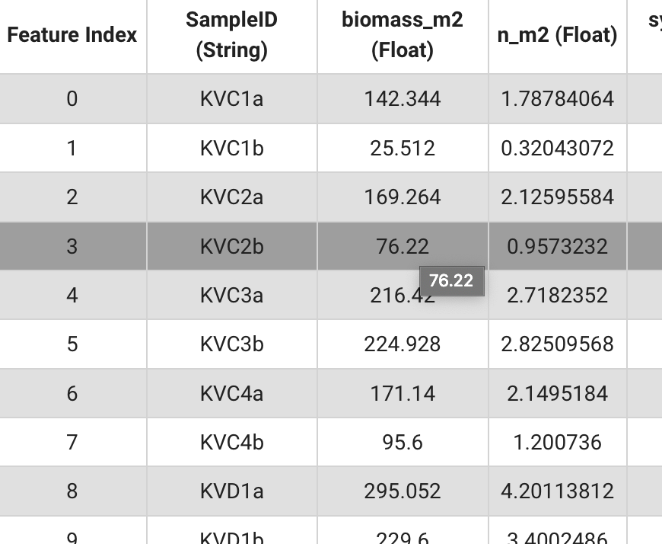
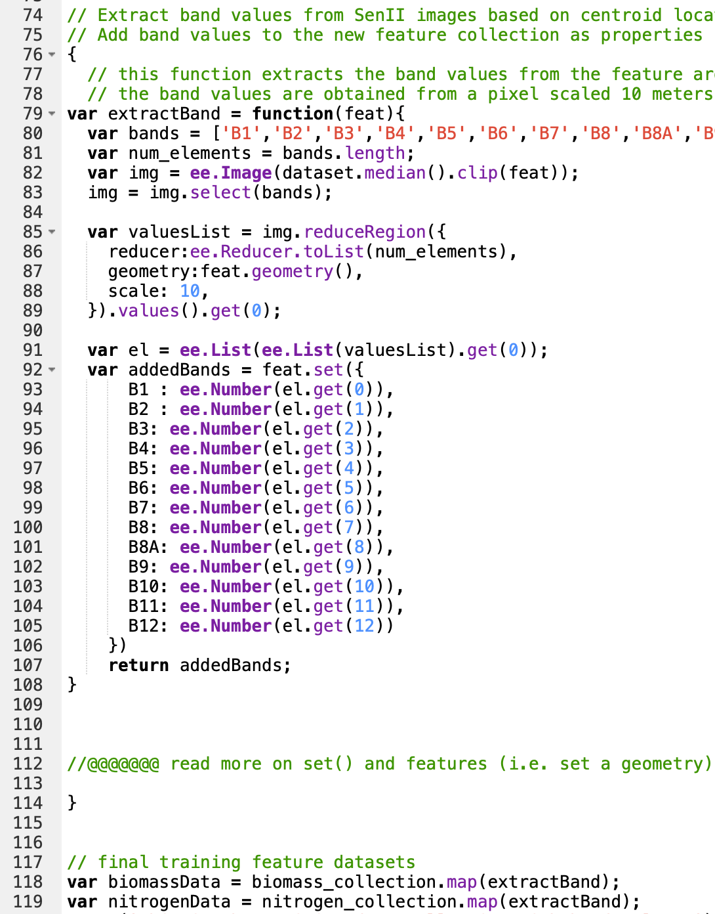
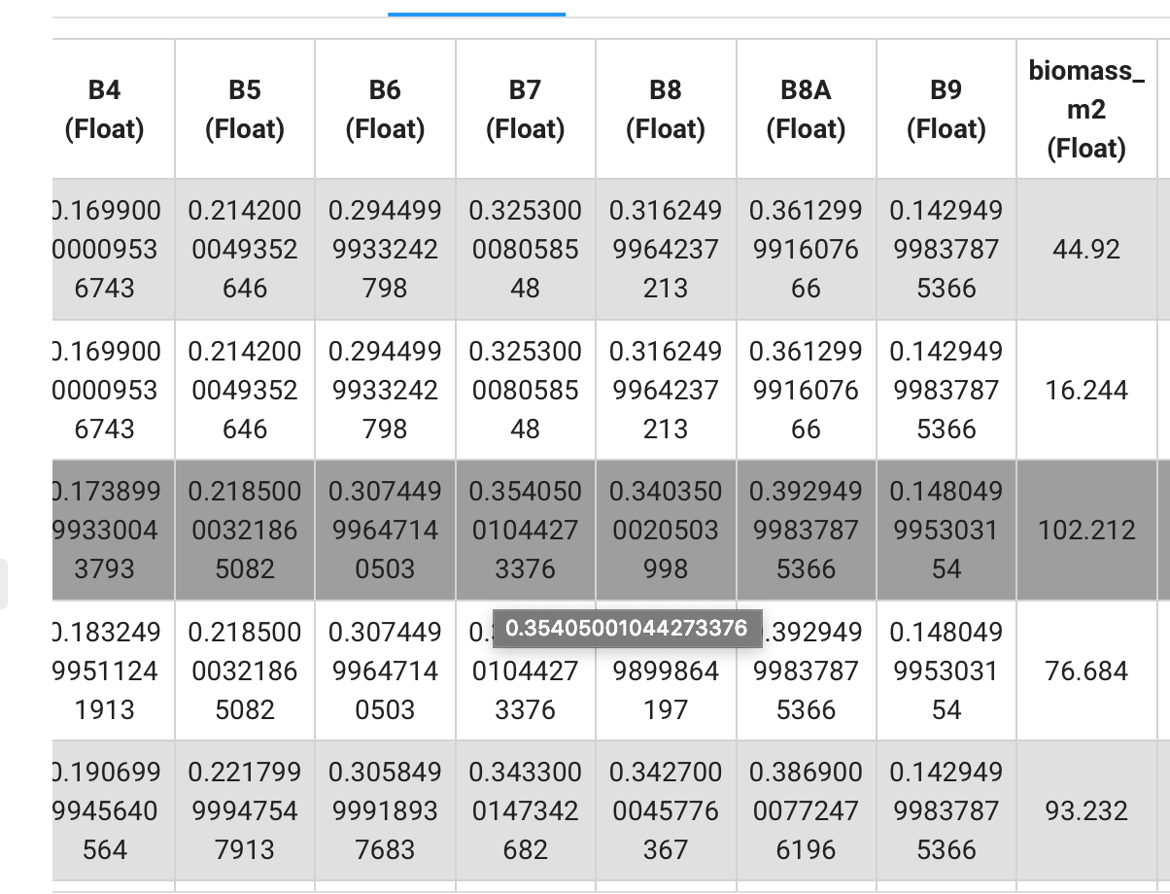
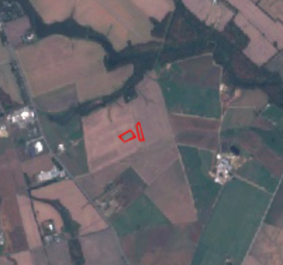
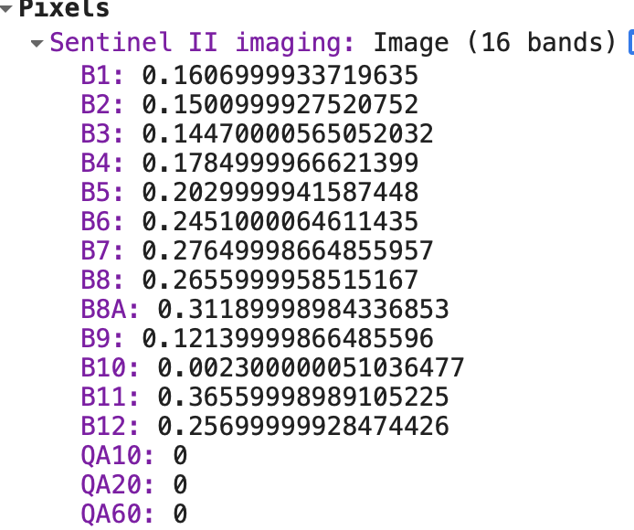
Field level data
Field quadrat image
Data processing script
Sentinel II image
Band values at 1 pixel
Feature collection for training
Data Processing workflow

Slide 9
Notes and Updates
Size of satellite images are accurate down to 10m by 10 m but field level data was taken from various small quadrats
Assumed that the quadrat data is summarizing the crop health for the larger 10 by 10 area
Crop data was taken at various points across a large field
Instead of producing a Machine learning model that predicts the biomass and nitrogen levels from images, there will be two models made
Using remote sensing indices formulas could add more feature variables to train on and potentially improve the model

Slide 10
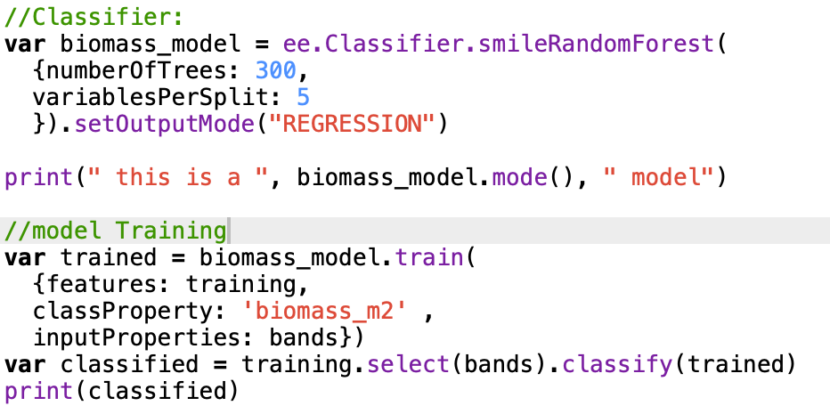
Task 2.1
Initial Machine Learning Model:
Using a random forest model and initial specs are: 300 trees to grow and the number of candidates at each split is 5

Slide 11
Task 2.1 /2.2
Began writing code to train a Random Forest model. The objective of the script is as follows:
Imports dataset of band and biomass values
Splits the dataset 80% training, 20% validation
Builds the random Forest Classifier
Convert model to perform regression
Begin model training
Test the validation predictions
Present validation predictions vs actual biomass values

Slide 12
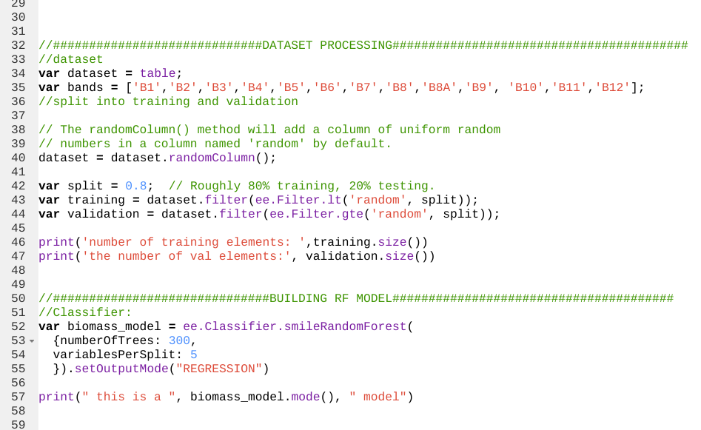

Slide 13
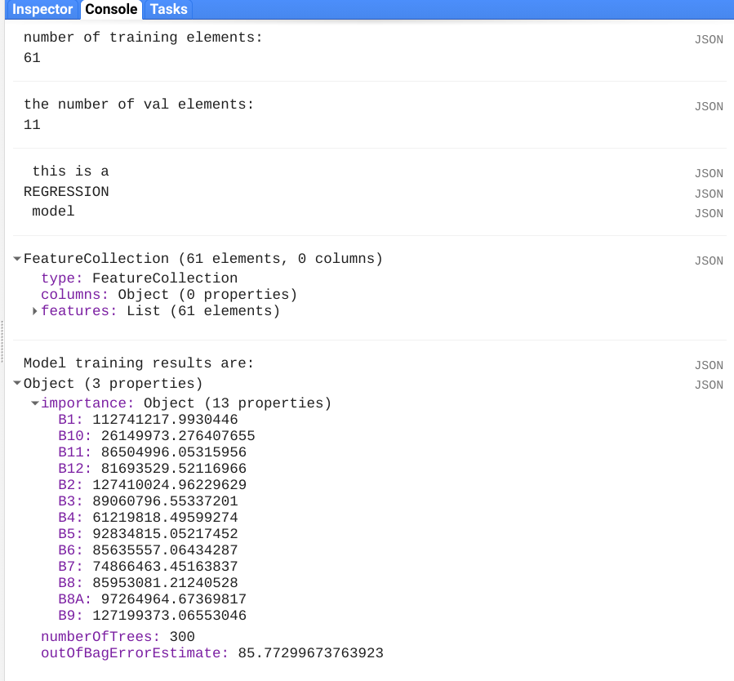
Random Forest model Initial results

Slide 14
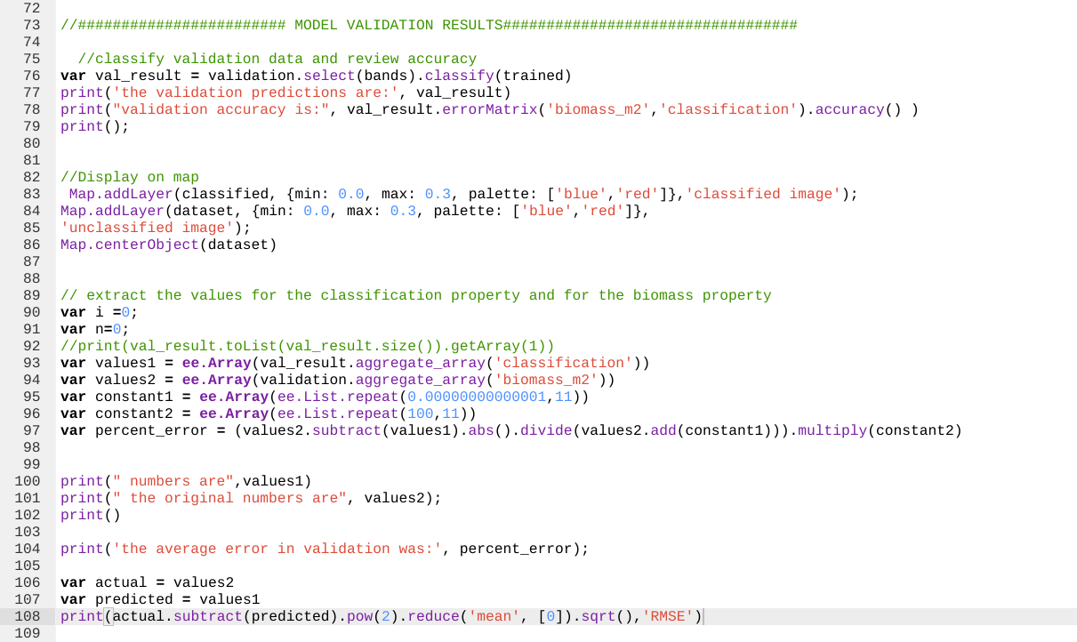
Interpreting Results

Slide 15
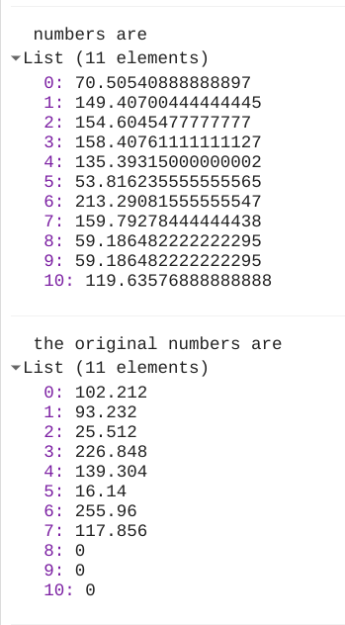
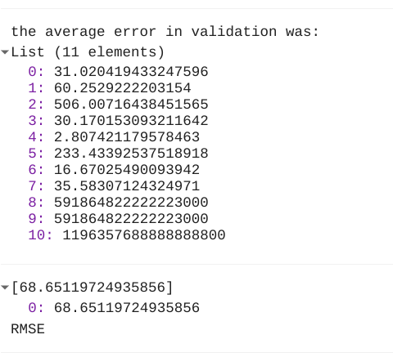

Slide 16
Troubleshooting
/Next steps
There are not many examples of utilizing a regression model within GEE
The initial training results are not very impressive for multiple reasons:
This data is extremely sparse because it consists of random values that don’t have much correlation
The features used for training are not vast enough for the model to find disparity in data
The parameters aren’t yet tuned to the dataset

Slide 17
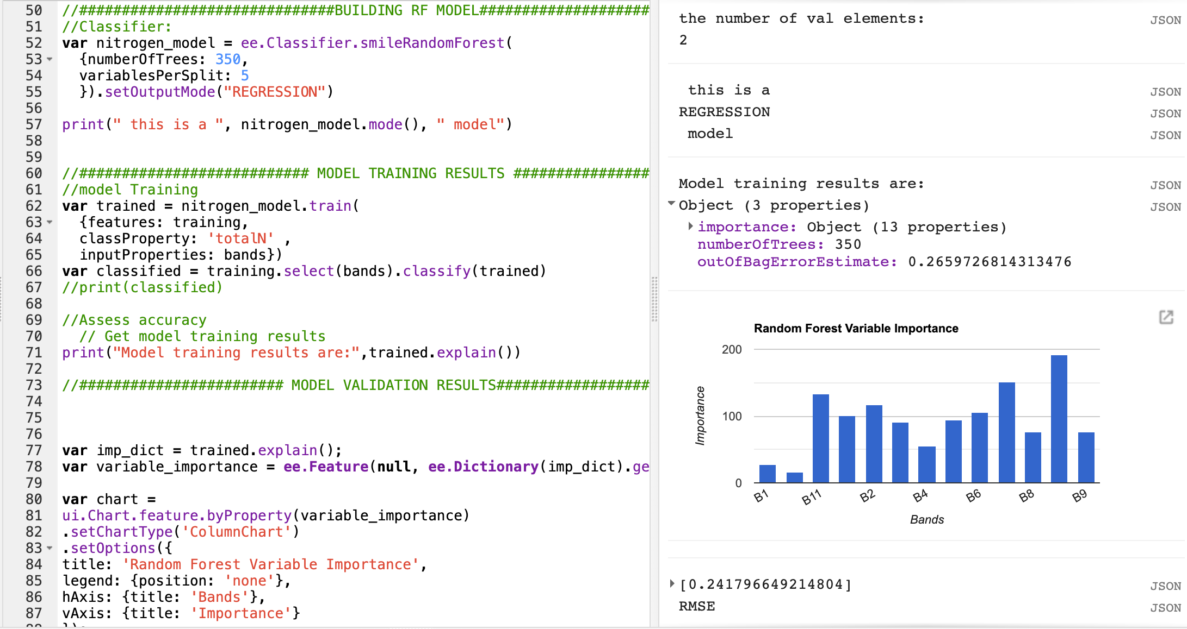
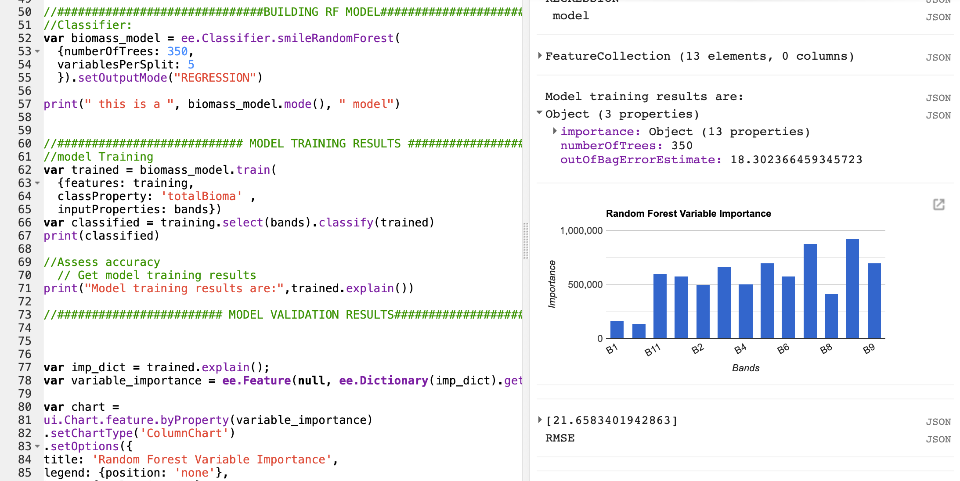
Task 2.1 / 2.2
Received the actual quadrat (field level) data values
Began training with the data in the current RF models
Looking for ways to improve the models results
Nitrogen Model results
Biomass Model results

Slide 18
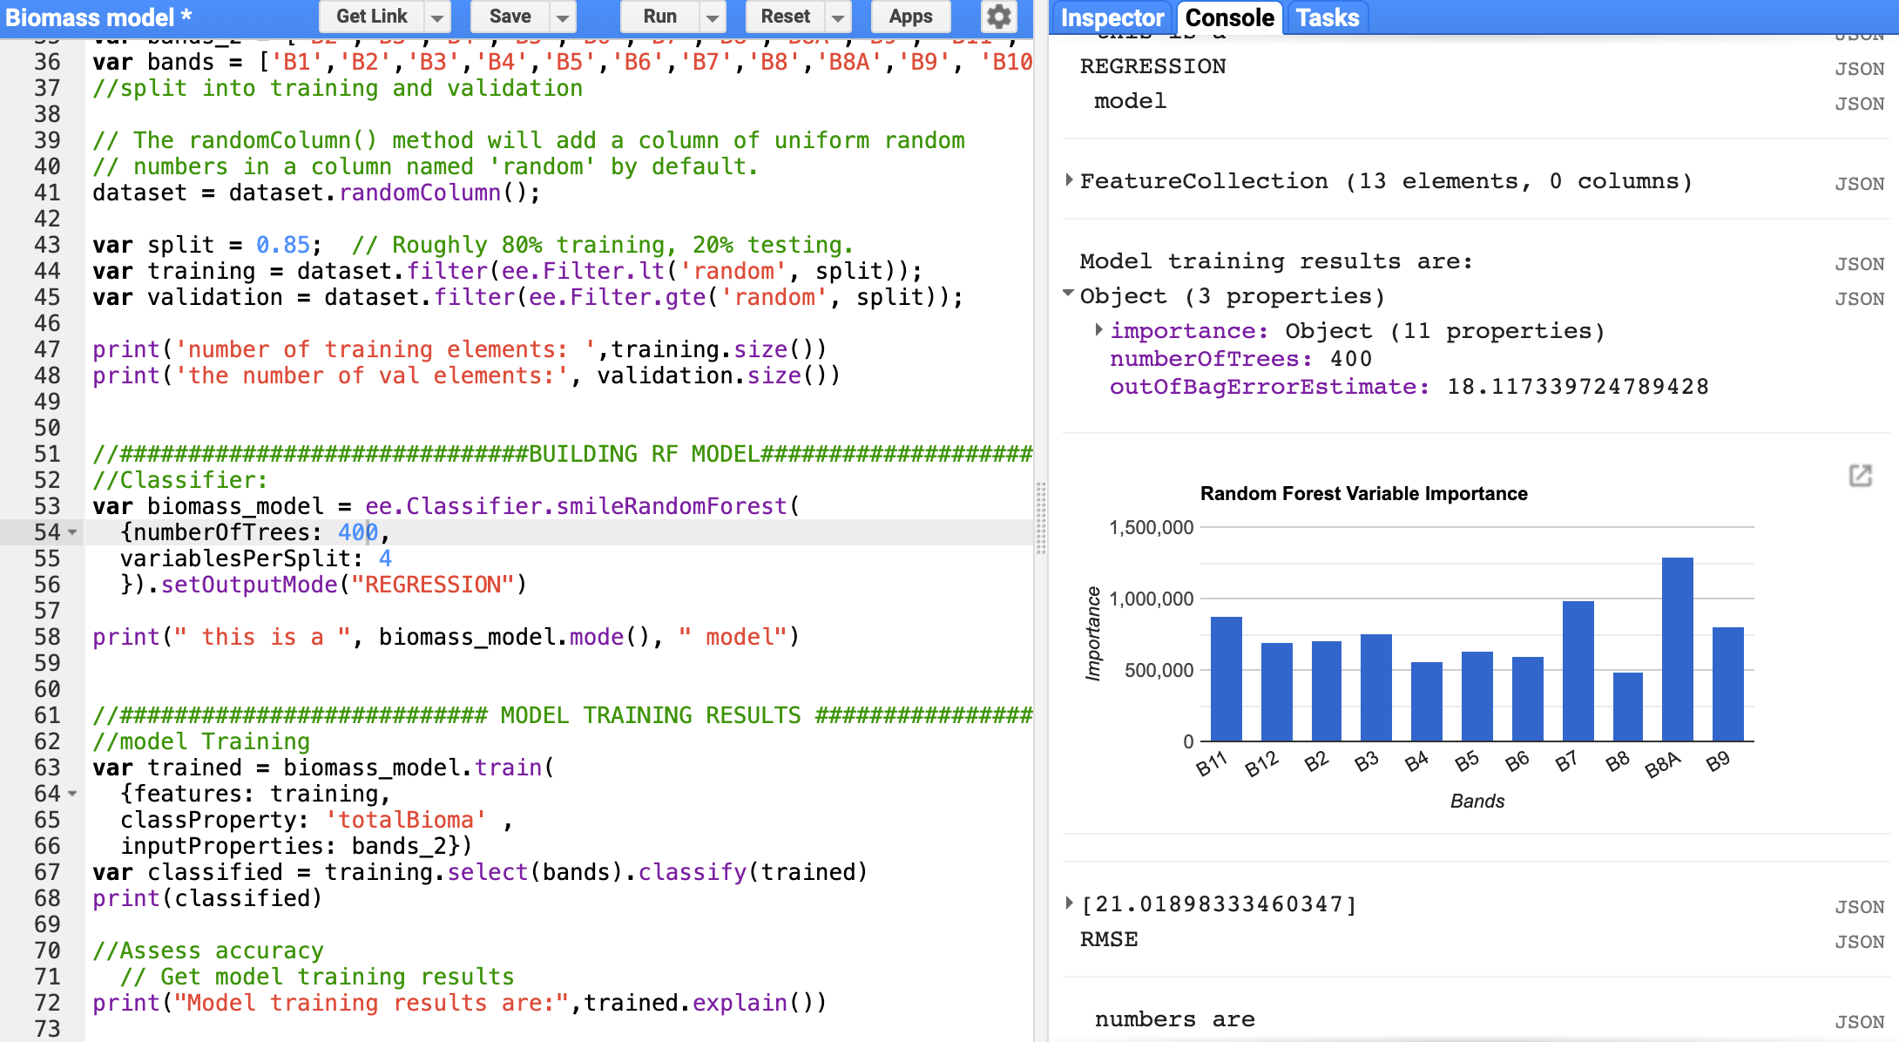
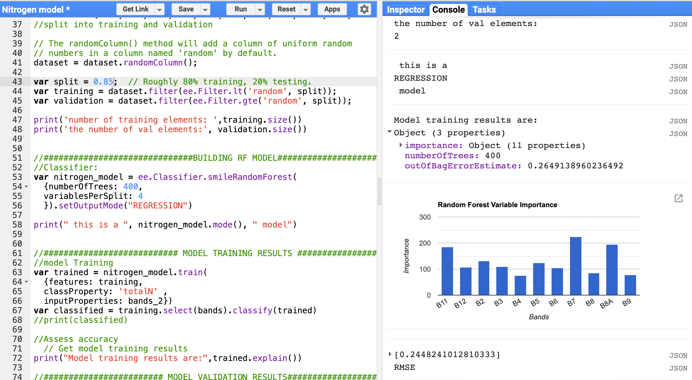
Biomass Model results
Biomass Model results
Biomass Model results
Nitrogen Model results

Slide 19
Troubleshooting
Quadrat data was much smaller than anticipated
The second part of the dataset consists of hyperspectral indices values/bands obtained from drone images taken across multiple fields
This data can only be obtained and uploaded through the GEE command line tool and python API (Many issues with installing the API)
Increasing the training data size would mean changing the input data for the model
From directly obtained biomass and nitrogen values to hyperspectral indices values to infer biomass and nitrogen
Looking for possibility of combining the data

Slide 20
Next Steps
Add satellite indices formulas as additional features to train on, in order to improve the model results despite having a smaller training dataset.
In the case of challenges with training regression on satellite images and trouble finding documentation on similar efforts in Google Earth Engine has lead to looking into another platform to apply an AI regression model.
Note: https://www.kdnuggets.com/2019/06/5-ways-lack-data-machine-learning.html
http://www.sthda.com/english/articles/35-statistical-machine-learning-essentials/140-bagging-and-random-forest-essentials/#:~:text=training.samples%2C%20%5D-,Computing%20random%20forest%20regression%20trees,predicted%20value%20by%20the%20model.&text=The%20lower%20the%20RMSE%2C%20the%20better%20the%20model.

Slide 21
Model Refining and improvement:
(Tasks 2.2)
Initial response to training is the dataset is too small for the parameters and model to produce viable results.
Two Solutions:
Add more training variables to get further properties from each datapoint
2.) Perform workarounds to maximize the dataset

Slide 22
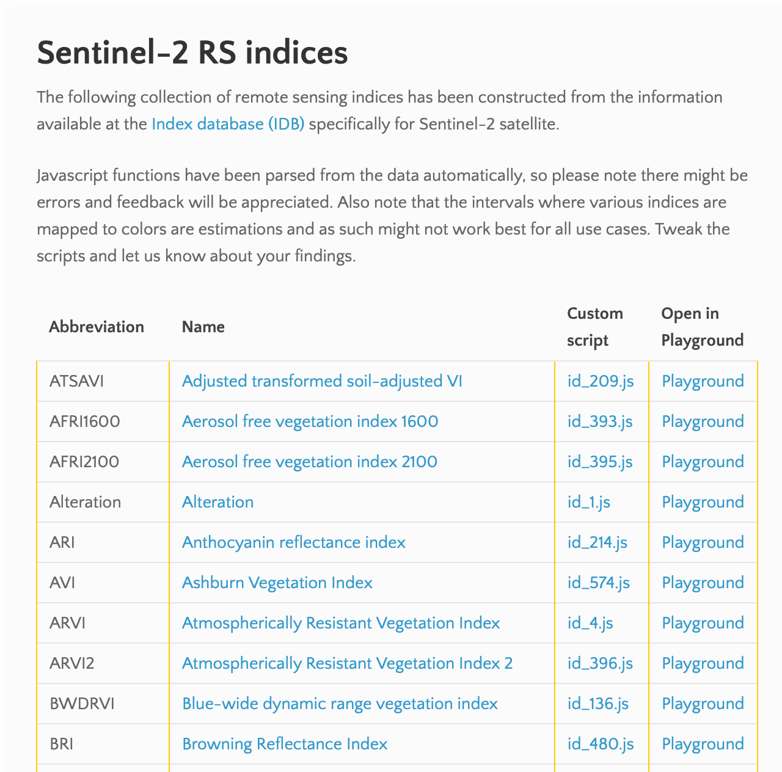
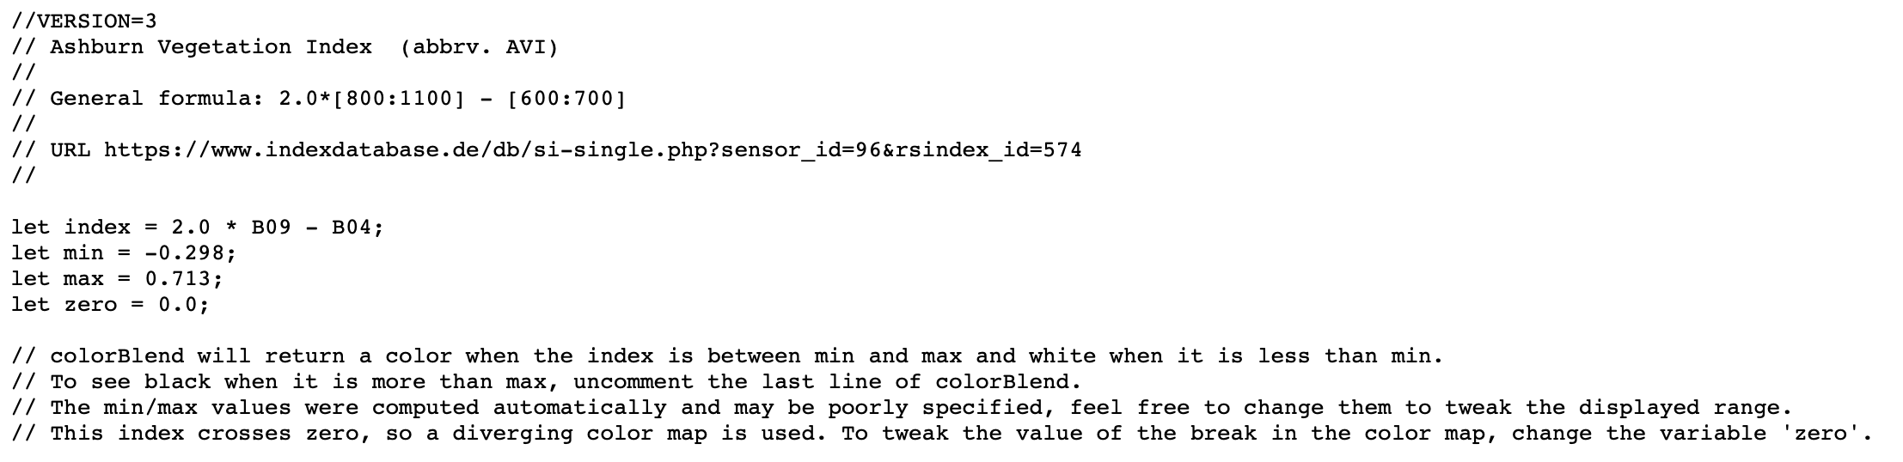
Solution/edit 1
Looked into adding the spectral indicies formulas as additional variables to the training dataset
Found a resource of about 200 RS indices specific to the Bands of the Sentinel-2 Satellite
Additional indices to add as training bands are:
AVI
BRI
CARI
CARI2
CVI
Chlgreen

Slide 23
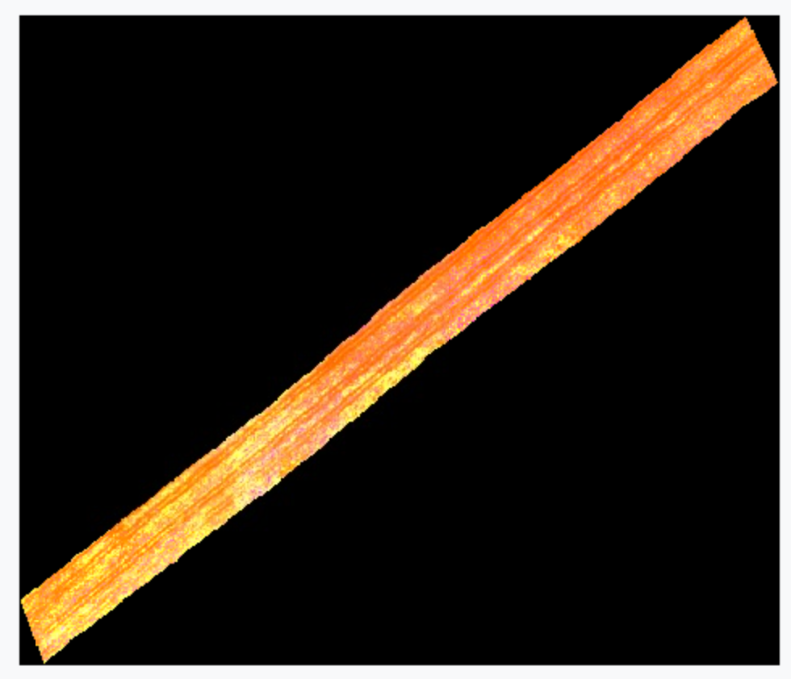
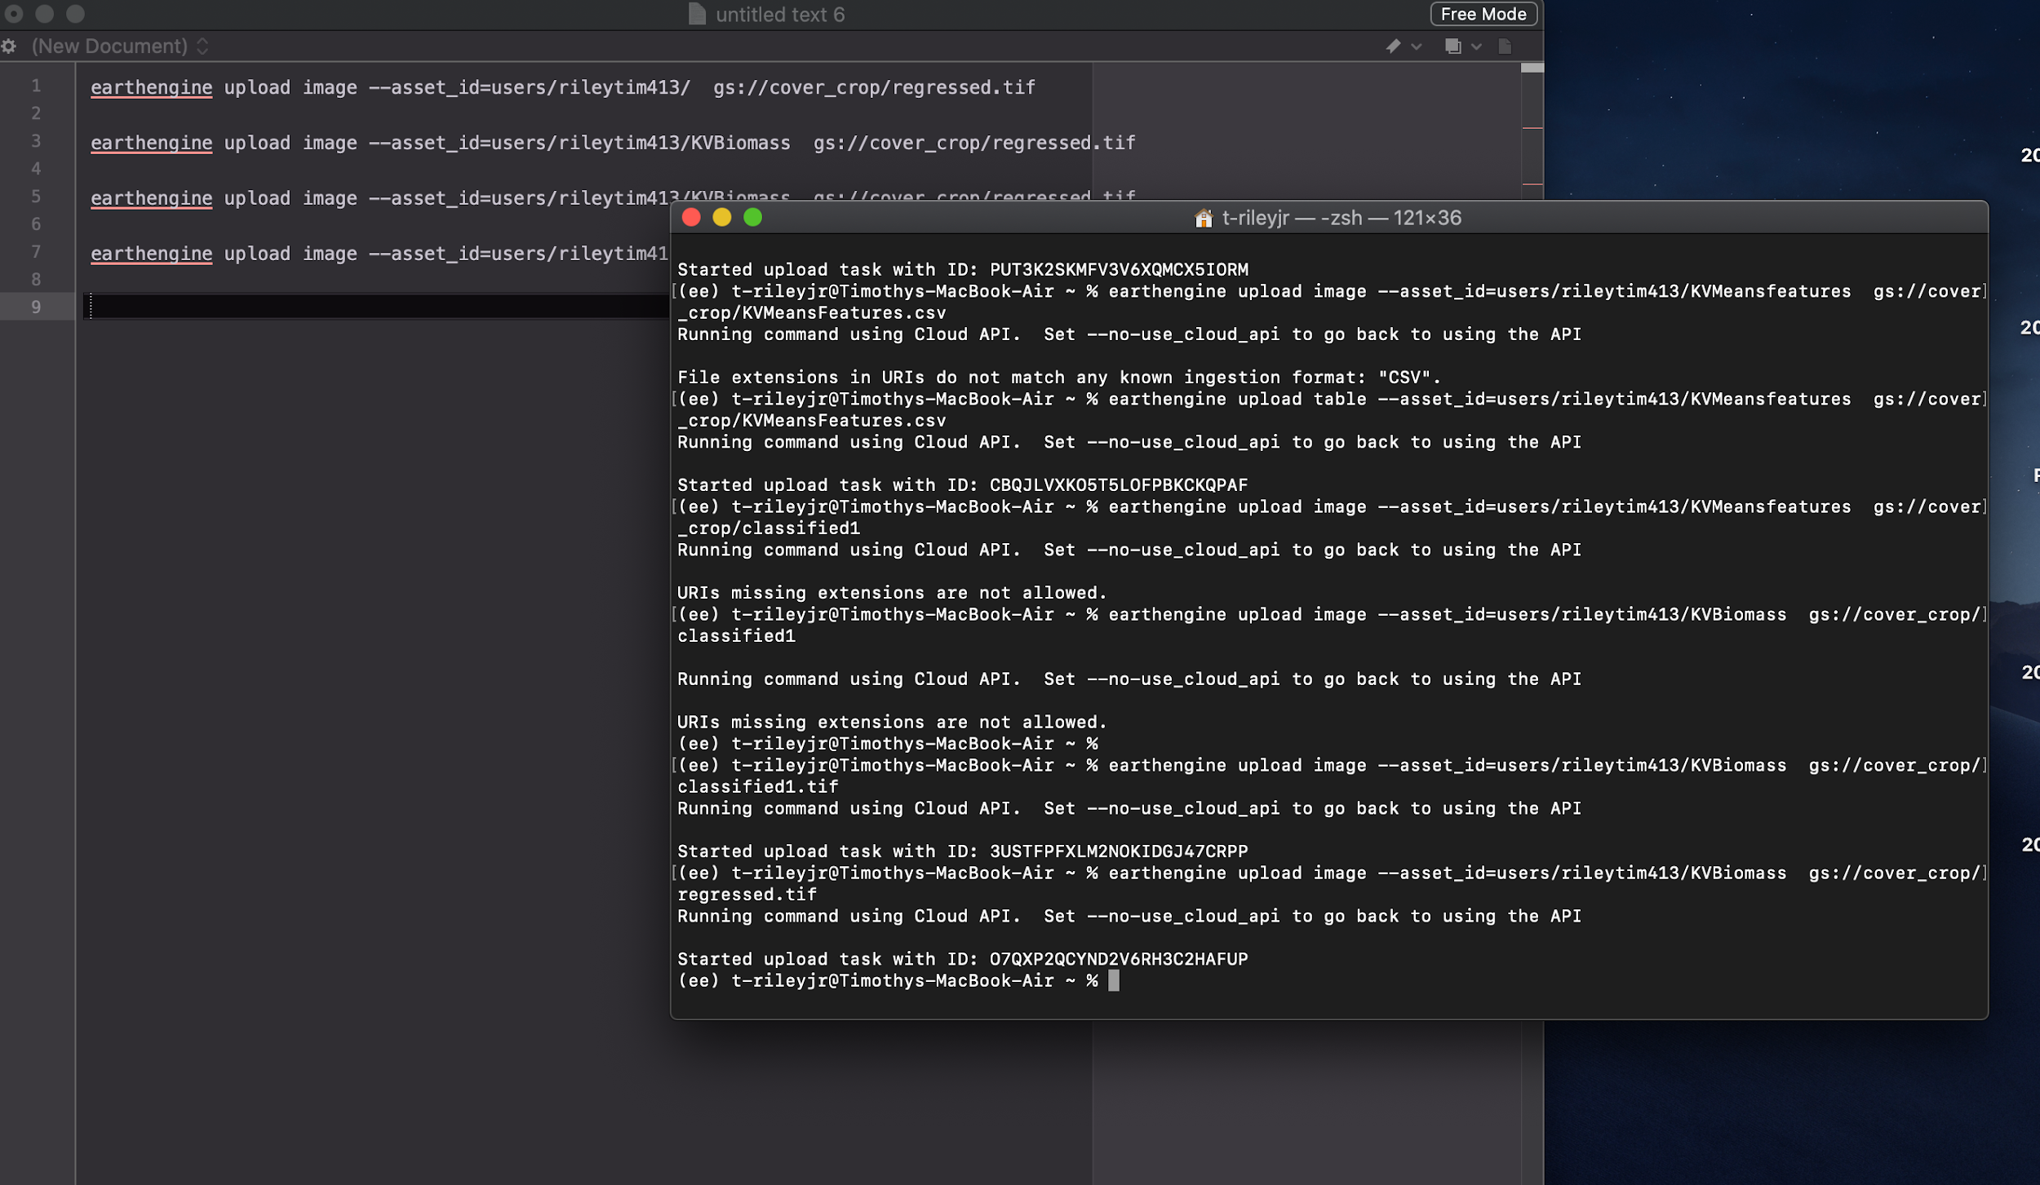
Solution/edit 2
Training Dataset Workaround:
Utilize the Hyperspectral drone data and original RF model to maximize the training dataset of Biomass and Nitrogen values
The hyperspec data holds a high volume of very precise field data.
The original RF model for Drone data performed very well on Biomass and Nitrogen predictions
New process:
Import 50 GB of hyperspec data to GEE
Import original RF model for drone imaging
Obtain Biomass and Nitrogen estimates from original RF model on hyperspec images
Utilize the variable estimates to maximize the training dataset
Continue the Sentinel 2 training process
Test accuracy against estimated data and quadrat data

